Slide 1

Accessing Matlab
If you are Barnard/Columbia-affiliated: https://www.cuit.columbia.edu/content/matlab
If affiliated with a different college or university, check their IT site for access to Matlab
Otherwise, go to: https://www.mathworks.com/products/matlab-online.html

Slide 2
Downloading the workshop Matlab Live script file
https://github.com/gabrielle9/teaching-demos/blob/main/CSC_workshop_HH_model.mlx

Slide 3
Modeling the Action Potential
Gabrielle Gutierrez, PhD
Barnard college, CSC workshop, fall 2023
Notes:
I'm going to talk about modeling the AP and about why that’s a useful thing to do.
In my 15 minutes I’m going to tell you the story of an equation and I hope you stick with me even if equations freak you out. Feel free to interrupt and ask me to clarify anything that isn’t clear to you.

Slide 4
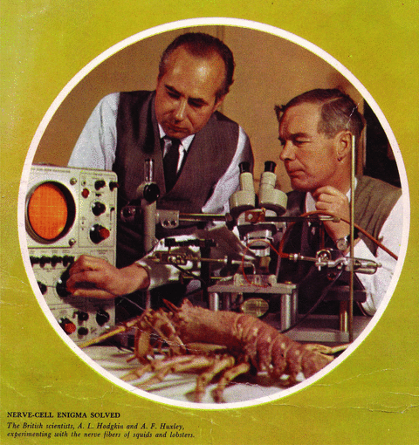
Hodgkin &Huxley
Notes:
Today you’ll get to explore a computational model of a neuron that was developed by H&H.
H&H won the Nobel prize in 1963 for having the insight to think of a neuron as a tiny electrical circuit.
They used some of the cutting edge techniques of their day in electrophysiology to record the electrical properties of neurons and to gather data. And they used that data to build a model.
They made one of the most famous models in neuroscience – a model of the AP. Even though they're shown here with a lobster, they used the giant squid axon for their recordings. Back then, researchers loved the giant squid axon because its large size made it possible to insert an electrode and to record the electrical activity in the neuron.

Slide 5
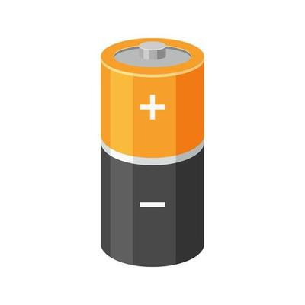
The neuron as an electrical system
extracellular
intracellular
Notes:
The big advance that H&H made was to not only think of the neuron as an electrical system, but to model it as one too. They relied on the
*known laws and equations governing electricity. For example, they knew that
*current - which is the flow of charge or the flow of ions – is equal to
*something called capacitance – which I’ll explain in a moment - times
*the change in voltage over time.
Current is the flow of ions through a conductive medium, and voltage is the potential difference between two points. It’s the difference in charge between two points – for, example, you can measure the potential difference between the inside of a cell and the outside.
I’m going to take a moment to explain capacitance but first - This is a Differential eqn which tells you how the rate of change of a variable depends on other variables. Here it's simply telling you that the rate of change of the voltage is proportional to the amount of current flowing across the membrane and to the capacitance. The more current there is flowing across the membrane, the faster the voltage will change, and vice versa.

Slide 6
Capacitance
Notes:
A capacitor is made up of two conductive plates with some insulation sandwiched in between. When the plates are subject to a voltage difference – like you’d get when you hook them up to the two terminals of a battery – positive charges will accumulate on one plate and negative charges on the other. Since charges can’t flow through the conductive medium, they kind of pile up at the plates. What this does is to store charge – or to hold charge across the 2 plates – forming an electric field across them. So even though charges don’t flow through the conductive medium between the plates, charged particles can accumulate on one plate and this attracts oppositely charged particles to the other plate.

Slide 7
The neuron as an electrical system
extracellular
-
+
+
+
+
+
intracellular
-
-
-
-
-
+
Notes:
The cell membrane is like a capacitor because the intracellular medium and the extracellular medium are conductive mediums where ions can freely move around while the lipid bilayer of the cell acts like an electrical insulator. So an imbalance of charges between the intracellular and the extracellular mediums can create and hold an electrical force across the membrane.
The current we’re talking about in these equations is the current or charge flowing across the membrane. You’ll recall that I said but a moment ago that charge can’t flow across the capacitor because it’s held at the “plates”. The insulating layer is preventing charges from moving across it. So what do you think we need in order for current to flow across the membrane?
"V" is the voltage, and for this eqn what you're looking at is a differential equation because this is the derivative of the V wrt time.

Slide 8
The neuron as an electrical system
extracellular
intracellular
Notes:
H&H did experiments that helped them to elucidate the roles of different ions, like Na and K, in the action potential. So they were able to build more detail into their model about how these ionic currents interact in the neuron.

Slide 9
Ohm’s law
Notes:
For their model, they relied on Ohm’s law which is a fundamental law of physics that comes from the study of E&M.
Ohm’s law says that *current is equal to *conductance times *voltage.
Conductance tells you how easily ions can flow. Things like wires and water act as conductors.
And this all fits in with the biological picture, because H&H know
*that the cell membrane has pores in it that permit ions to flow across. So these channels help conduct the flow of ionic current. And they know that these pores, or ion channels, are usually specialized for particular types of ions.

Slide 10
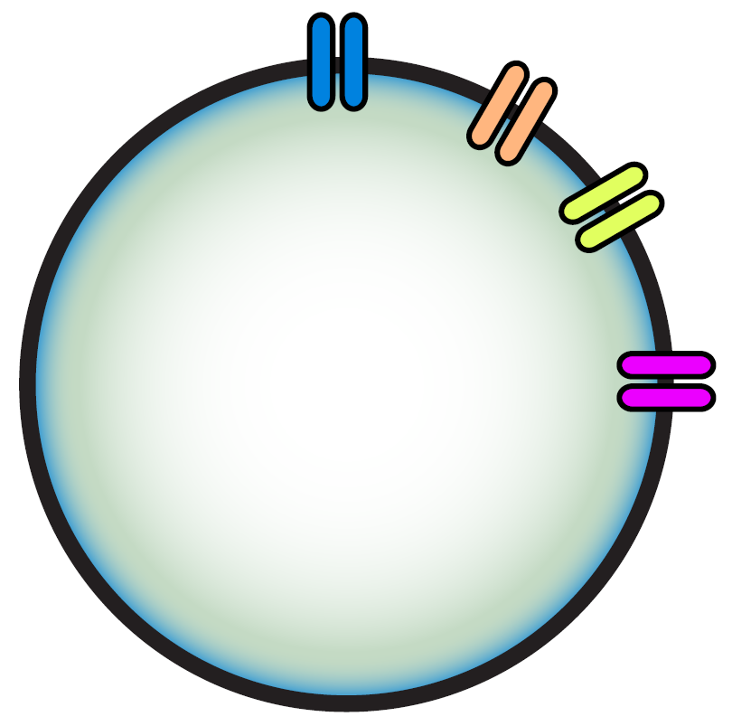
Driving force
K⁺
Na⁺
Na⁺
Na⁺
K⁺
K⁺
K⁺
K⁺
Na⁺
Notes:
The driving force is the difference between the membrane voltage, V, and the equilibrium potential for a particular ion, E. The equilibrium potential is the potential at which a given ion species is in equilibrium. None flows in and none flows out. This mostly depends on the concentrations of that ion on the inside and outside of the cell. For example, K+ tends to have a higher concentration inside the cell than outside, so it tends to diffuse out of the cell. It takes a very negative voltage to reverse that.
H&H were able to use these driving forces to put more detail into their equation with the help of Ohm‘s law.

Slide 11
Ohm’s law
Notes:
Now they could put Ohm’s law together with this driving force into their voltage equation so that the amount of current flow generated by the K ions, for example, is described by the driving force for those ions times the conductance from K ion channels.
This is a nice model, but as it stands, it's not going to get you any actions potentials.
*They had to put in even more detail for the conductances. In experiments, they and others noticed that conductance wasn't constant. And it was already known that the conductors in the cell membrane – the ion channels – can open and close. So H&H had to figure that the conductances are not static constants, *they change as a function of voltage and time. Hence why they're called voltage-dependent ion channels!
*The way they handled this was to express the conductance in terms of a static constant and some gating variables.
I'm going to focus on the K conductance.
G_bar is the maximal conductance. It's a constant that tells you how much conductance there is when all of the K channels are totally open. So that’s the upper limit on conductance for K.

Slide 12
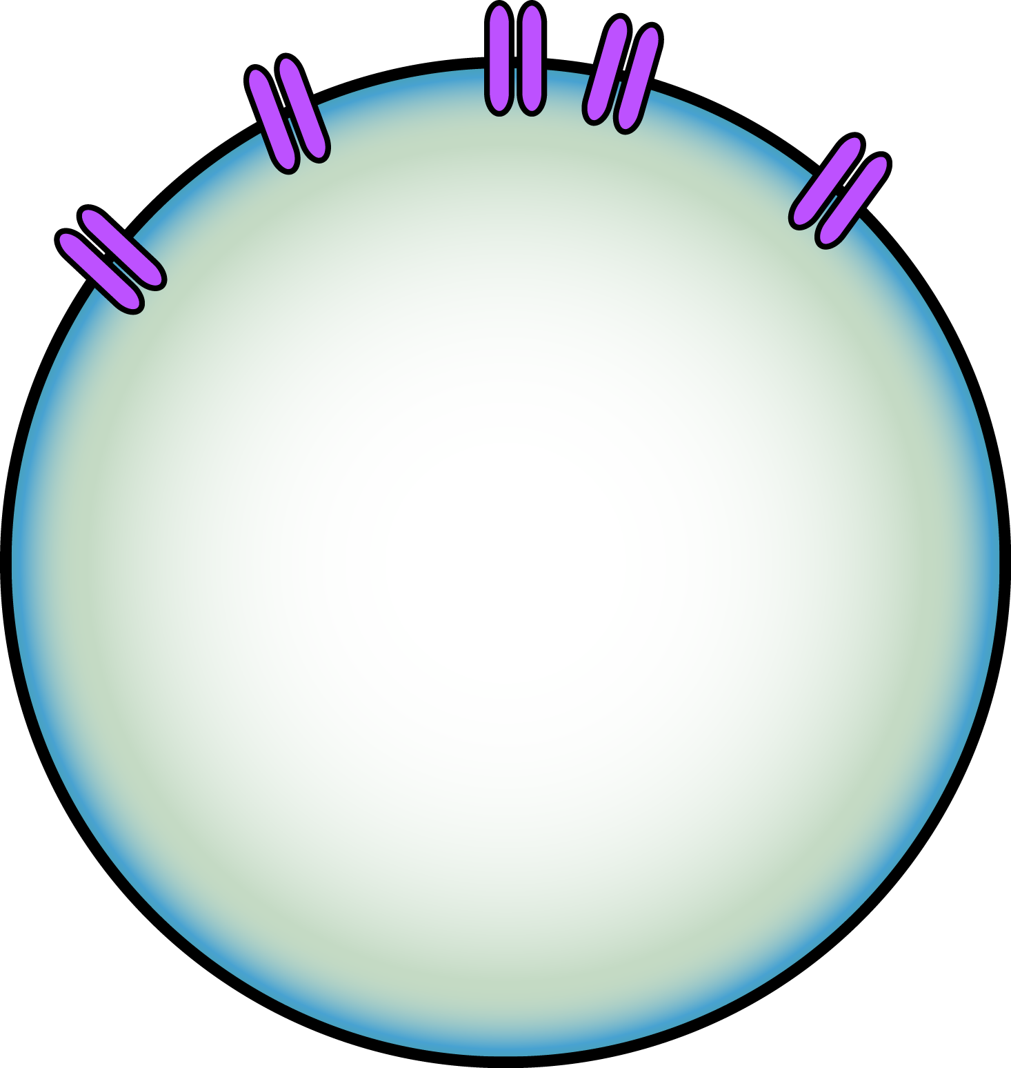
Gating Variables
Notes:
The gating variable, n, is the part that is dependent on voltage as you can see in this plot where voltage is on the x-axis. N goes from 0 to 1.
*When the voltage is really hyperpolarized, n is close to zero - so pretty much no K channels are open.
*As the voltage becomes more depolarized, a greater proportion of K channels are open.
*Finally, almost all of the K channels are open at very depolarized voltages.
The reason I wanted to tell you about gating variables is because modeling these gating variables …

Slide 13
Gating variables made a biological prediction!
Notes:
…
When H&H were fitting their model to the data, they found that
*an exponent of 4 happened to produce the best fit. Which seemed to indicate that there were
*4 gates that needed to be open before the maximum amount of conductance could be reached. Later, it was found that the K channel has
* 4 subunits which act like those gates.
So this model made a prediction about the number of K subunits based on just the behavior of the electrical currents.

Slide 14
What can you do with a model?
Notes:
So now that you know all about the H&H model, what can you do with a model?
Well, you've got a K current and a Na current. You can...

Slide 15
What can you do with a model?
Notes:
*add a Chloride current, or you can...

Slide 16
What can you do with a model?
Notes:
*inject a current signal into your model neuron. Depending on the parameters, you might need a pulse of current to get APs going in the model.
or you can ...

Slide 17
What can you do with a model?
Notes:
*connect it to other neurons with a synaptic current.
There are endless possibilities for what you can create with this model as a foundation.

Slide 18
What can you do with a model?
Notes:
Looking at the detailed voltage equation, there are a lot of things here that you could *tweak. Modifying your model would let you see what the action potentials might look like when, for example, the equilibrium potential for Na is changed. Or maybe you want to see what happens when the cell has fewer K channels. Then you’d reduce the K conductance. In fact, that’s what a computational neuroscientist who studies epilepsy might do because of the known links to K channel abnormalities that neurobiologists have discovered.
{Models help us understand complex systems and to make predictions. The HH model predicted subunit structure of ion channels and inactivation mechanisms.
Can do mathematical analysis. }

Slide 19
Why build models?
Models help us understand complex systems
Models make it possible to do certain kinds of mathematical analyses
Models allow us to make predictions about biology and nature
Notes:
So why build models? I hope I've conveyed to you that
*Models help us understand complex systems. It’s not so easy to imagine how K and Na ions interact in a neuron to produce an action potential, but a model can help you to see exactly how that happens – and why that happens. Turns out it was just physics.
*… Take the H&H voltage equation, for example. At its core it’s a differential equation. There are mathematical tools and methods for studying those kinds of equations and determining whether a system produces oscillations, or only produces transient responses. The equation can be analyzed to tell us how the system behaves under different conditions. Some of those conditions might be very difficult to create experimentally but very easy in a model.
*Models also allow us to make predictions about biology. The HH model predicted the subunit structure of ion channels and inactivation mechanisms. This is useful because ion channel subunits are really tiny and you just can’t see them under most kinds of microscopes. So how would you ever know that there are 4 of them?! There are actually lots of different ways to go about determining the structure of ion channels, and building a model of the current dynamics through those channels is one way to “see” what’s there.
That’s all I have but please feel free to ask me anything. There are no dumb questions! Also, if neuron models sound interesting to you, I already have some openings in my lab for student researchers. Please get in touch with me to discuss if that’s something you might like to do.

Slide 20
How Hodgkin & Huxley solved their model equations

Slide 21
Download the Matlab livescript
https://github.com/gabrielle9/teaching-demos/blob/main/CSC_workshop_HH_model.mlx

Slide 22
